Slide 1

MS Power BI& Hive
https://towardsdatascience.com/connecting-apache-hive-to-microsoft-power-bi-d460e2278720

Slide 2
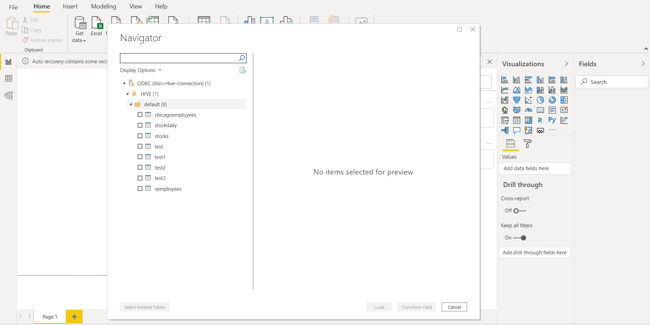

Slide 3
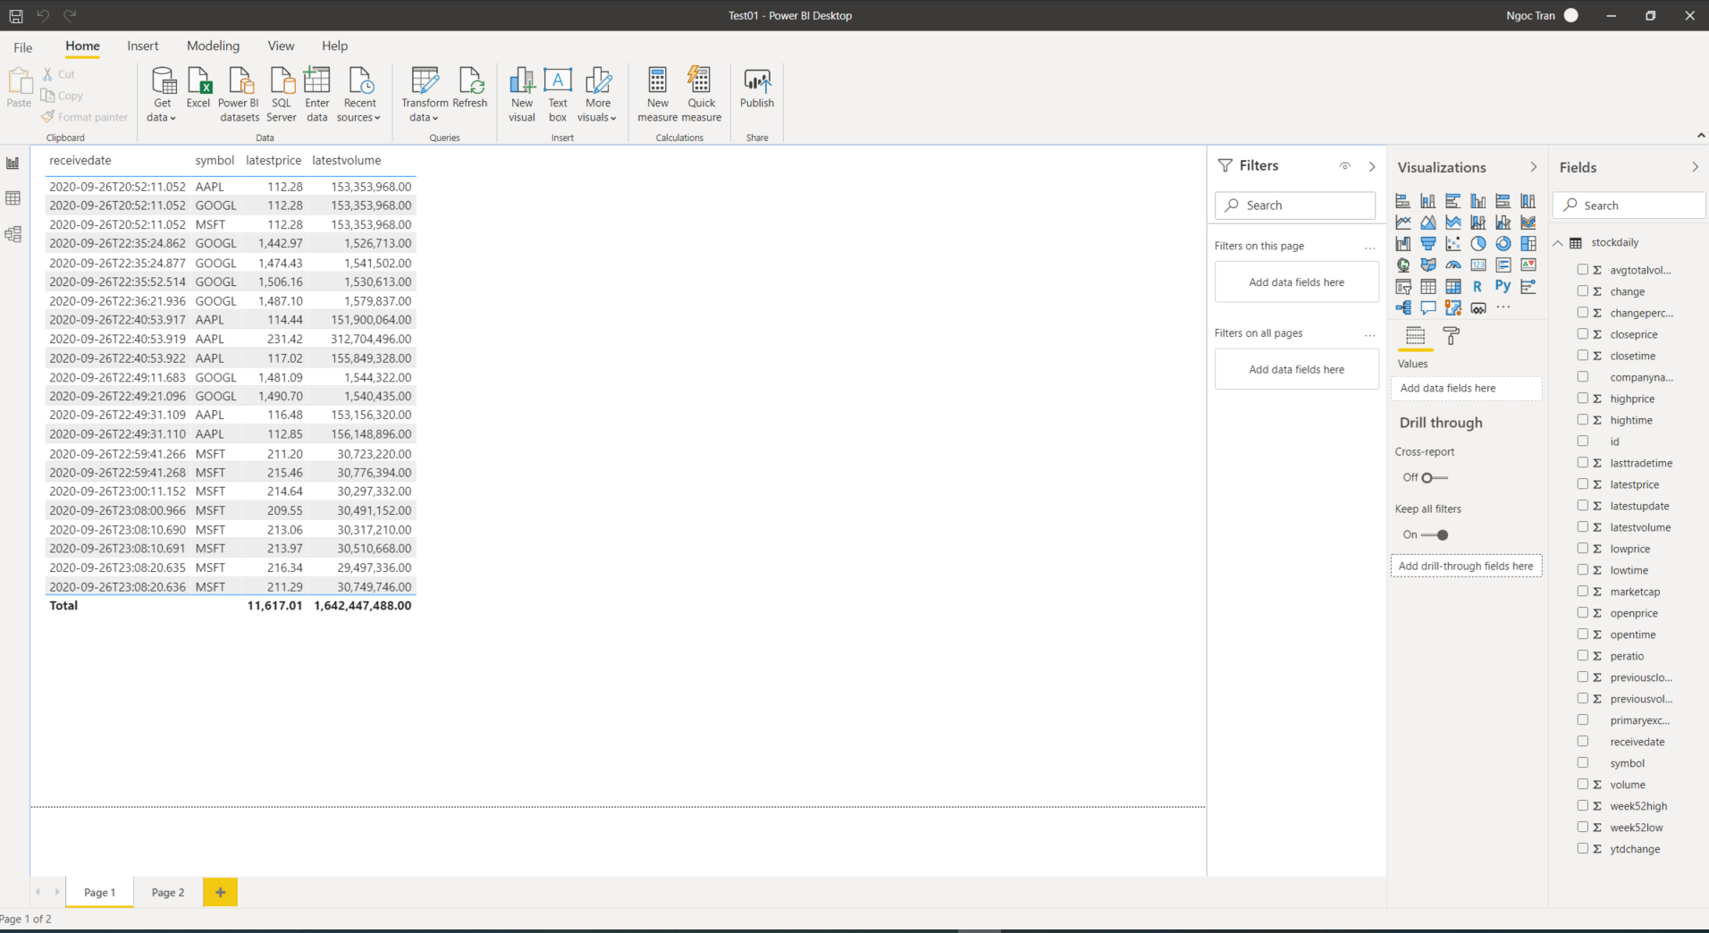
Power BI Desktop

Slide 4
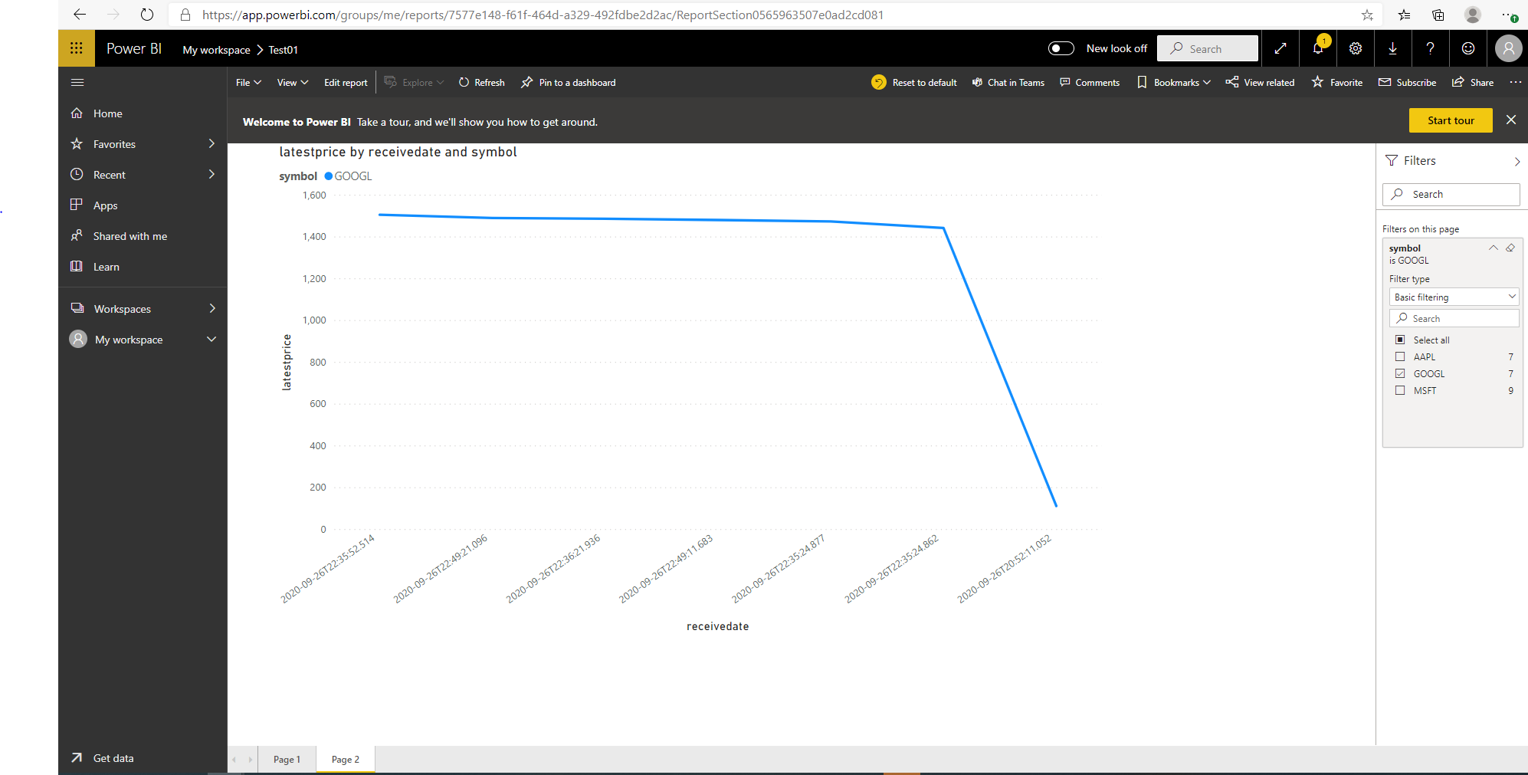
Power BI Web

